Slide 1
lesson: http://jbadomics.github.io/tnseq/
repo: http://github.com/jbadomics/tnseq/

Slide 2
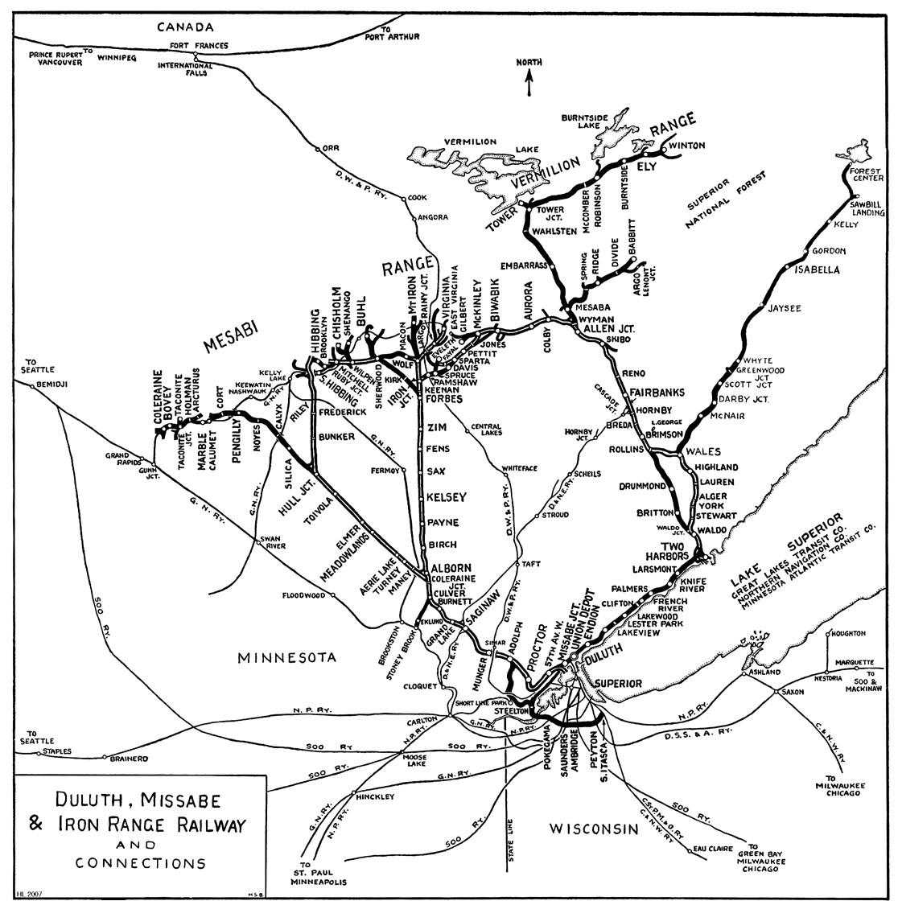

Slide 3

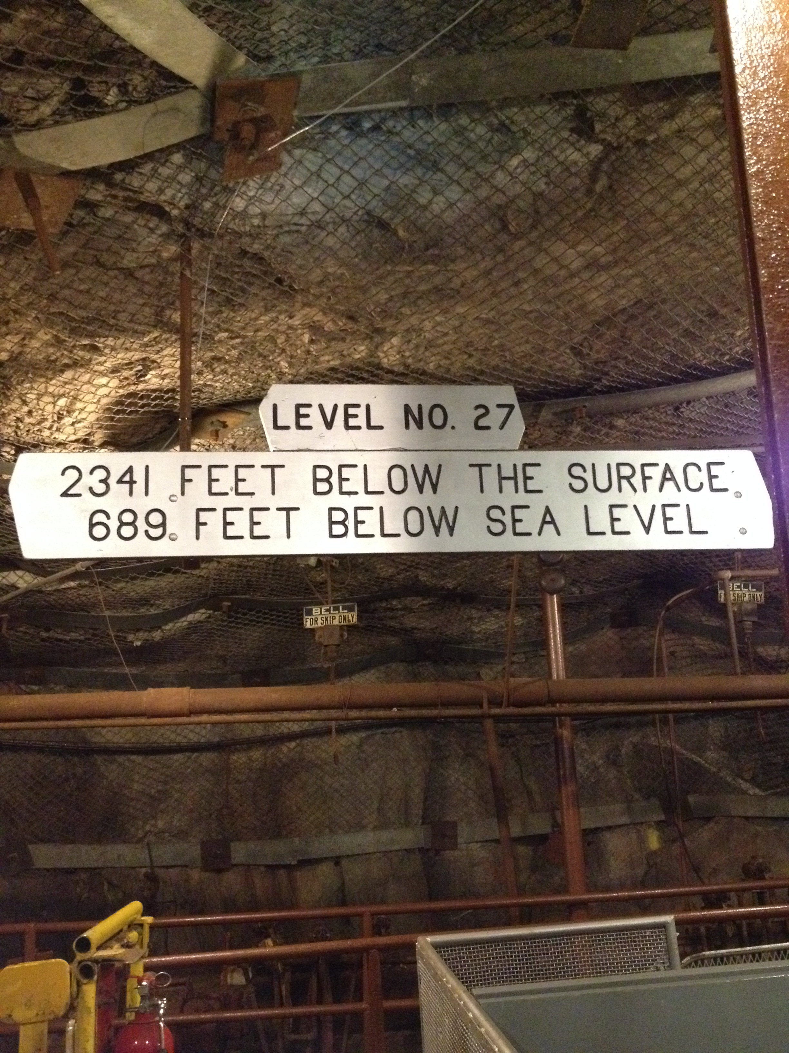

Slide 4

Photo: Chi Ho Chan
Notes:
EXTREMELY low biomass

Slide 5

DCO Census of Deep Life shotgun metagenomics

Slide 6
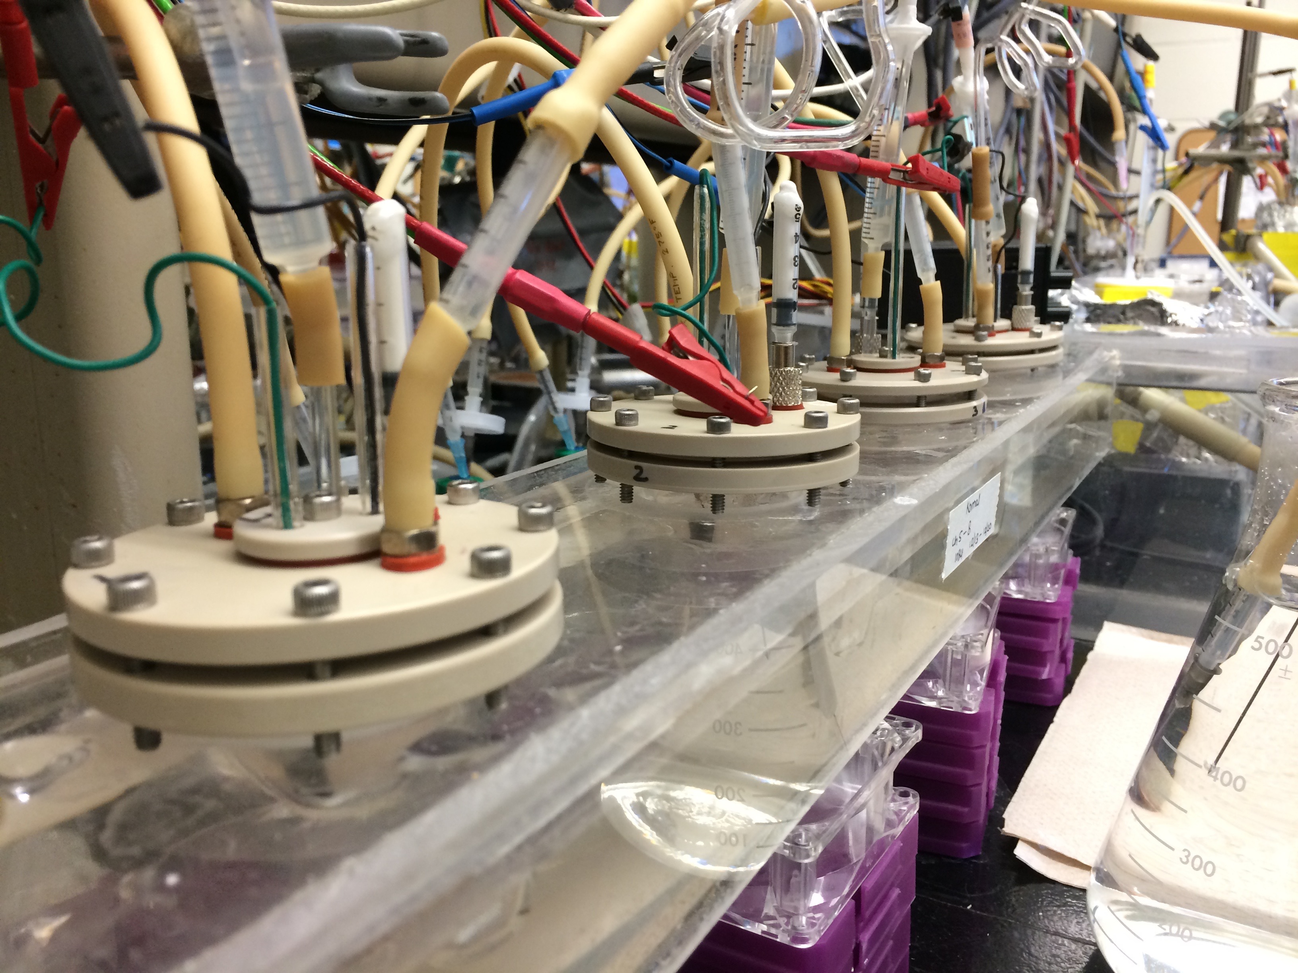

Slide 7
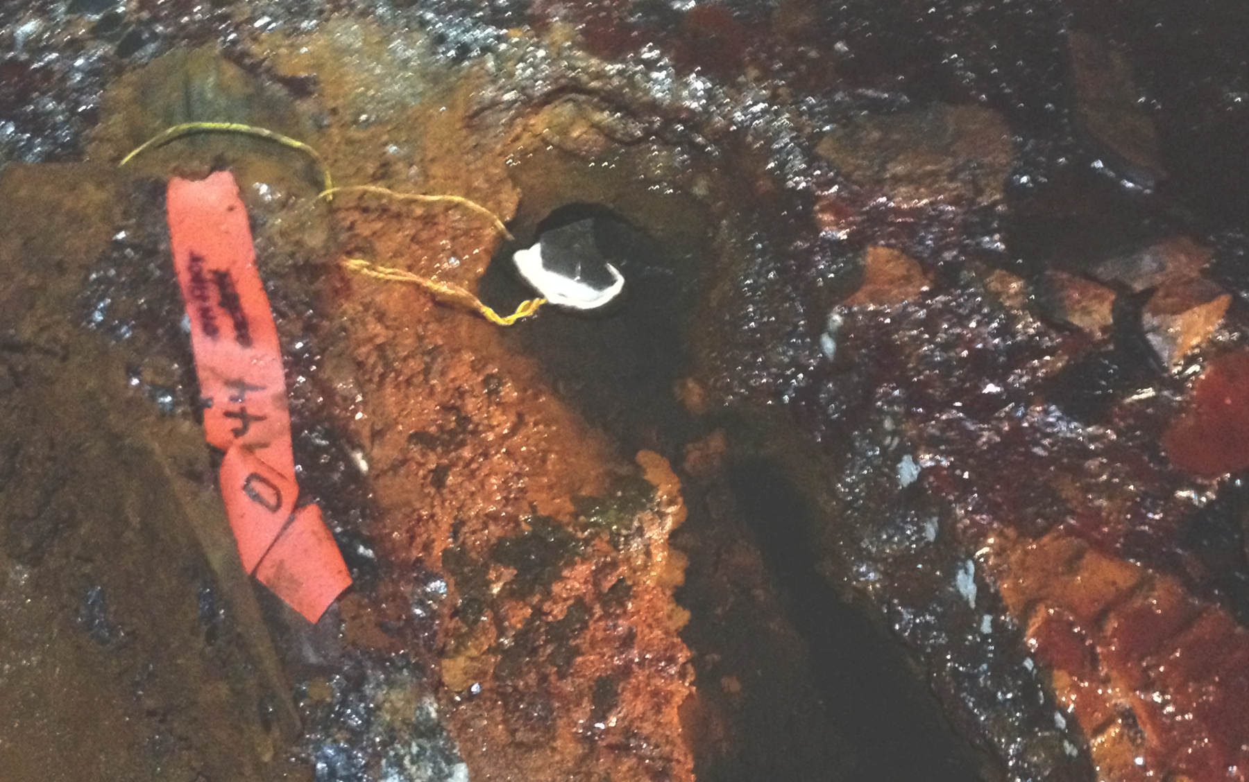
medium
replacement
with Zara Summers
Illustration: C. Levar

Slide 8
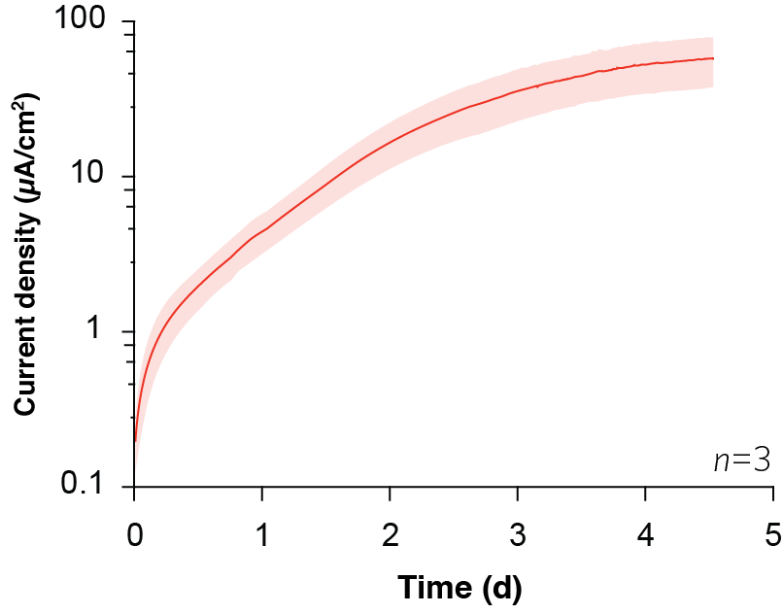
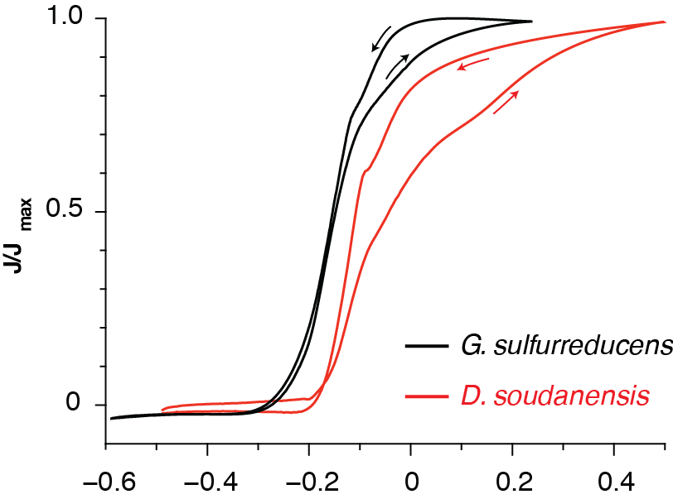

Slide 10
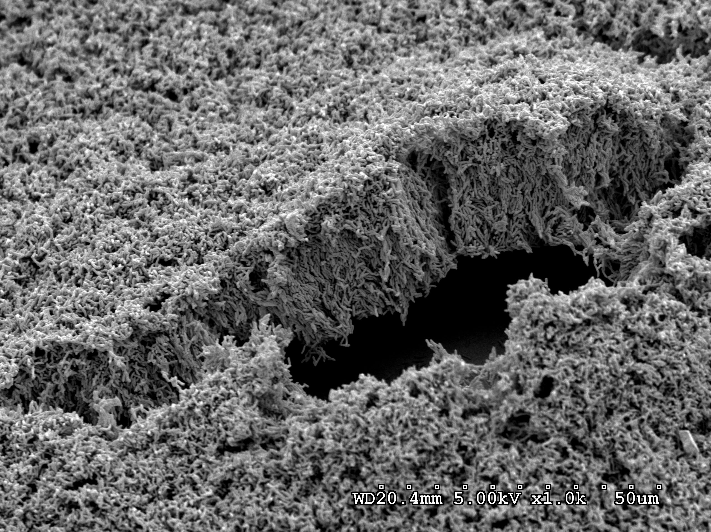
acetate
CO₂
electrons
electrode
Photo: Ying Liu

Slide 12

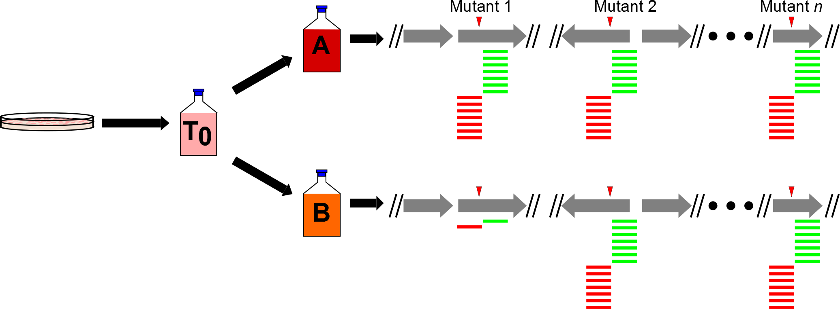
Tn-Seq- “Toothpicks and logic” meets next-gen sequencing
Saturated
library
with n
mutants
Outgrowth of parent
library (T₀) under
different conditions
(A and B)
DNA isolation, Mme1 digestion,
amplification, and deep
sequencing to compare outgrown
libraries with parent library

Slide 13
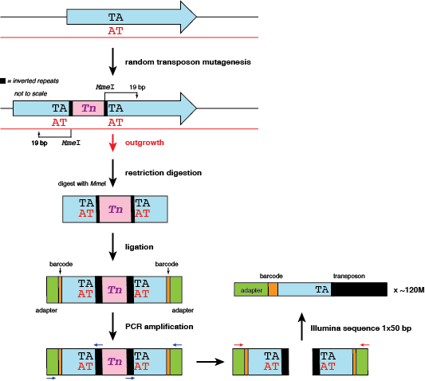

Slide 14
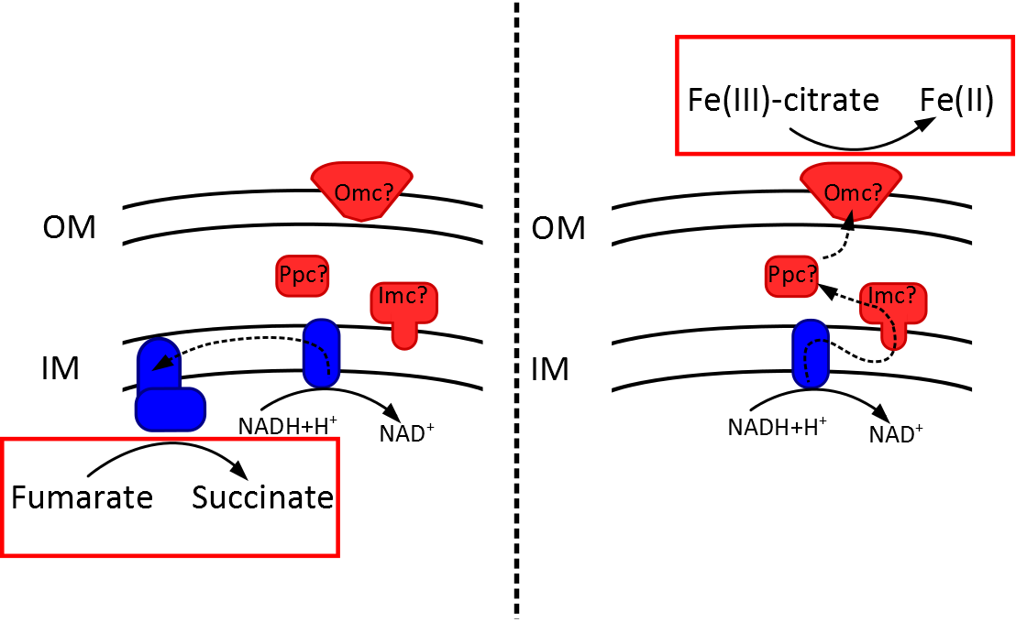
Condition A:
Fumarate reduction
Condition B:
Fe(III)-citrate reduction

Slide 15
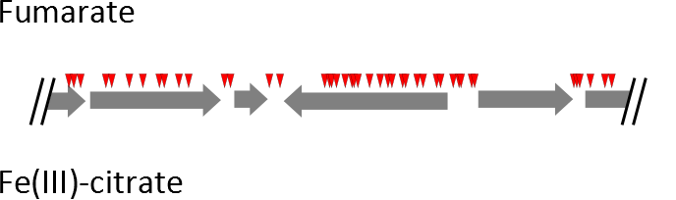
Tn-Seq in Geobacter
Notes:
So, most basically, when we look at data like these, a few things start to pop out. First, each of these red triangles represents a unique transposon insertion location that we identified in our parent library. So just based on the number of insertions present in our starting library, we seem to have a pretty good chance of identifying genes required for growth under these different conditions.

Slide 16
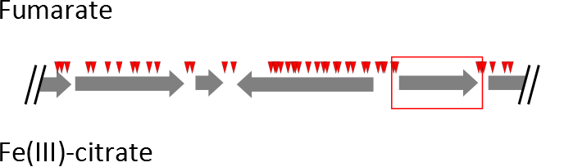
Tn-Seq in Geobacter
Notes:
Next, we see genes that don’t have any insertions, even though it may have the TA sites needed for transposon insertion. This likely indicates that this gene is required for growth under the conditions in which the parent library was generated, or perhaps was essential under all outgrowth conditions. Of course, the possibility exists that we were just extremely unlucky in that we didn’t get any Tn hits to the gene.

Slide 17
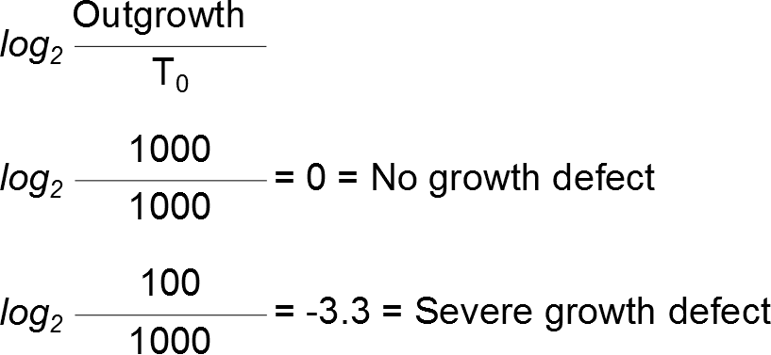
Log₂ ratios to identify genes of interest
Notes:
And finally, we can use the relative number of reads mapped to the flanking regions of each one of these transposon insertion sites to calculate some relative cost of each one of these insertions. The way we do that is by asking how many reads were mapped to these flanking regions in these two outgrowth conditions when compared to the total number of reads mapped to that same insertion in the parent library.

Slide 18
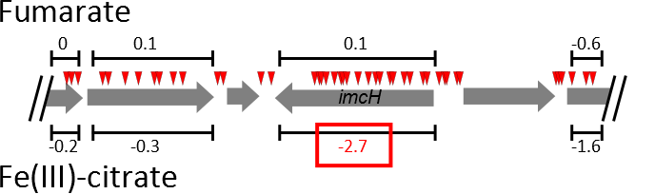
Log₂ ratios to identify genes of interest
Notes:
And finally, we can use the relative number of reads mapped to the flanking regions of each one of these transposon insertion sites to calculate some relative cost of each one of these insertions. The way we do that is by asking how many reads were mapped to these flanking regions in these two outgrowth conditions when compared to the total number of reads mapped to that same insertion in the parent library.
PHOSPHOSERINE AMINO TRANSFERASE

Slide 19
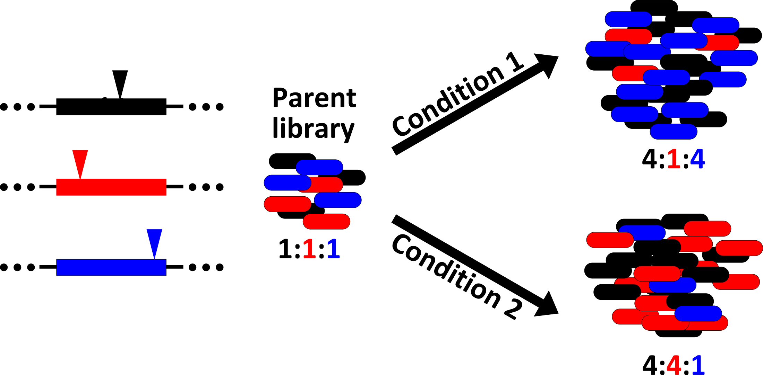
Tn-Seq: Test 44,000 mutants at once

Slide 20
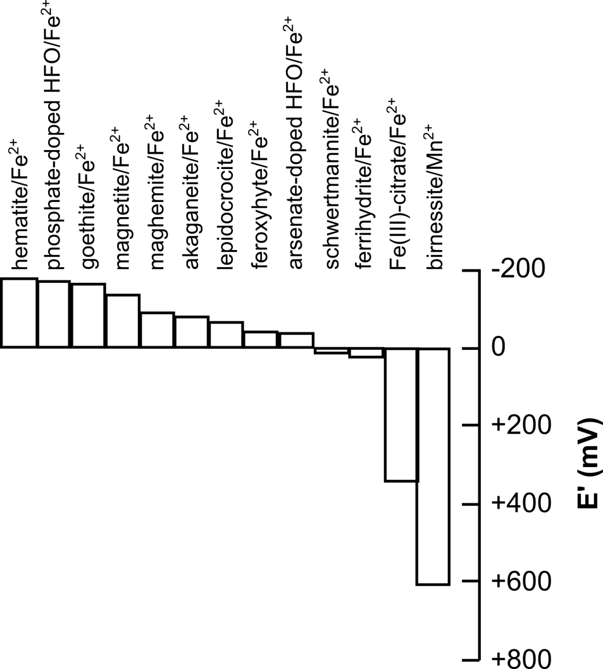
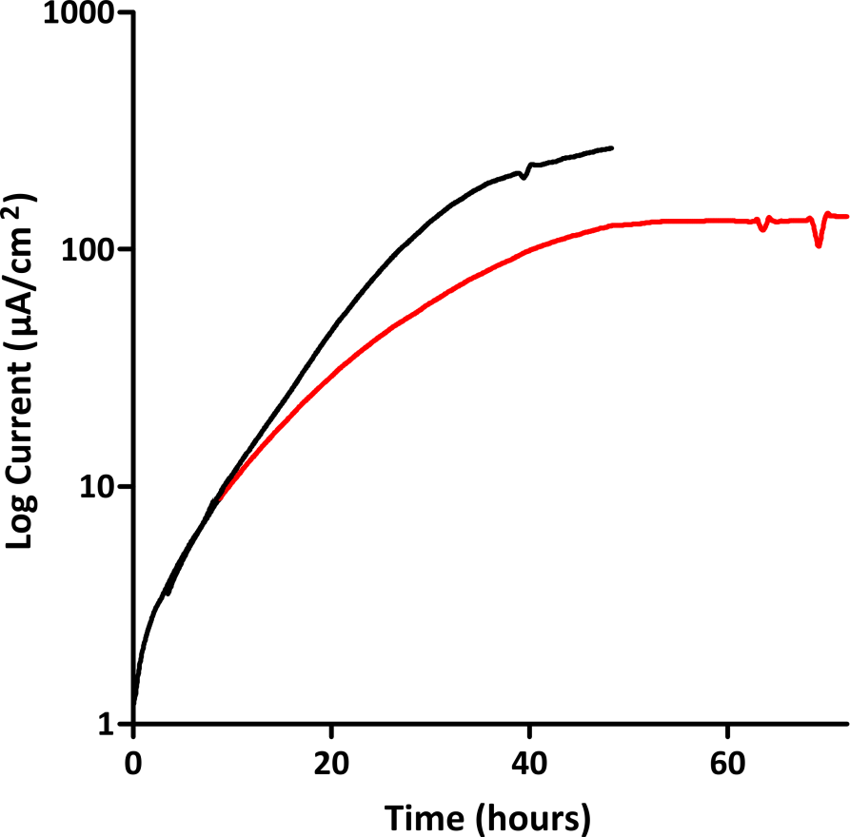
Tn-Seq using electrodes at different potentials
“Low”
-0.10 V vs SHE
“High”
+0.24 V vs SHE

Slide 21


Tn-Seq: Test 44,000 mutants at once

Slide 22
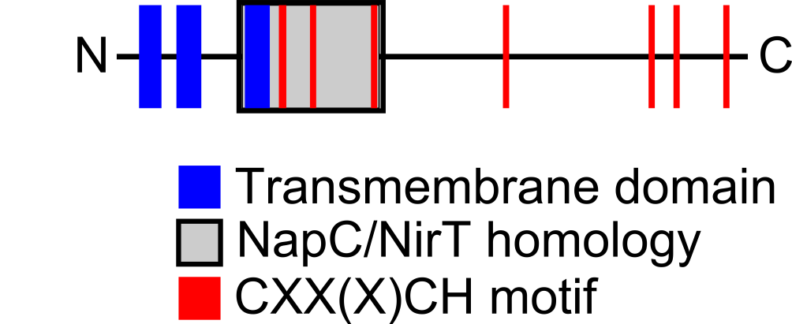
Potential dependent phenotypes

Slide 23
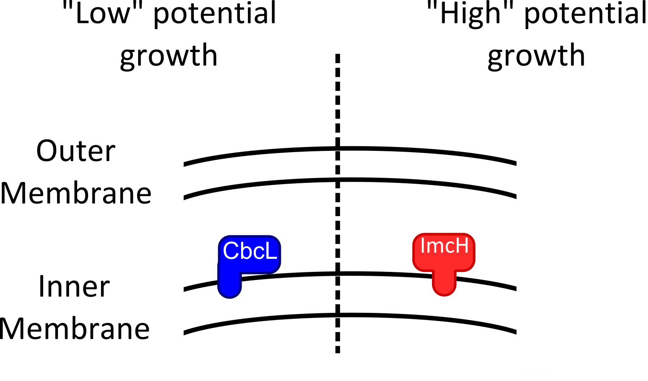

Respiration in response to redox potential

